Slide 1
Classification and clustering of bank data using Hadoop, pig and r
GUIDED BY,
Dr.S.BALAKRISHNAN,
Department of Information Technology,
SKCET.
PROJECT SUBMITTED BY,
AGILAN S 15EUIT003
ARUN KUMAR A K 15EUIT011
FAHEEN FATHIMA B N 15EUIT030
VINITHA B 16EUIT518

Slide 2
PROBLEM STATEMENT
Based on the current salary, assets owned by the customers may not help to classify the customers accurately.
Customers with valuable assets and good salary may show reluctance to payback loans
Customers with not much valuable assets and an average salary may pay the loans properly
Hence understanding the behaviour / nature customers become tedious for the banks.

Slide 3
OBJECTIVES
To classify the customers based on their previous transactions(not only on current salary and assets)
To categorize them into low, medium and high risk customers.
To decide if the holder can be approved of the credit card and loans
To enables banks to do marketing by understanding their customers.
To enable the banks to identify the target customers.

Slide 4
Literature survey
Ivanilton Polato a,b,n , Reginaldo Ré b , Alfredo Goldman a , Fabio Kon,” A comprehensive view of Hadoop research—A systematic literature review”, in Journal of Network and Computer Applications 46(2014)
A systematic literature review to assess research contributions to Apache Hadoop. Our objective was to identify gaps, providing motivation for new research, and outline collaborations to Apache Hadoop and its ecosystem, classifying and quantifying the main topics addressed in the literature.
RESULT:
The systematic review presented in this paper demonstrates that Hadoop has evolved into a solid platform to process large datasets. the research community has provided the development of new features to the framework

Slide 5
Literature survey
PrathyushaRani Merla, Yiheng Liang, “Data Anlaysis Using Hadoop Map Reduce Environment”, in IEEE International Conference on Big Data (BIGDATA), 2017
This project deals with analysis of YouTube data using Hadoop MapReduce framework on a cloud platform AWS. Hadoop multi node cluster is setup on private cloud called AWS (Amazon Web Services). Within AWS, I have set up EC2 instances with one name node and 5 data nodes. The video statistics obtained from the API is stored into the HDFS (Hadoop Distributed File System) and the data processing is done by the MapReduce system.
RESULT:
Introducing data analysis using Hadoop and MapReduce. The efficiency of analyzing the data improves exponentially using MapReduce algorithms.

Slide 6
Literature survey
Feng Li, Beng Chin Ooi, M. Tamer Ozsu, and Sai Wu, ”Distributed data management using MapReduce”, in ACM Comput. Surv. 46, 3, Article 31 (January 2014)
MapReduce is a framework for processing and managing large-scale datasets in a distributed cluster, which has been used for applications such as generating search indexes, document clustering, access log analysis, and various other forms of data analytics.MapReduce adopts a flexible computation model with a simple interface consisting of map and reduce functions whose implementations can be customized by application developers. Since its introduction, a substantial amount of research effort has been directed toward making it more usable and efficient for supporting database-centric operations
RESULT:
A comprehensive review of a wide range of proposals and systems that focusing fundamentally on the support of distributed data management and processing using the MapReduce framework

Slide 7
Literature Survey
Arushi Jaina, Vishal Bhatnagara Ambedkar,“Crime Data Analysis Using Pig with Hadoop” in International Conference on Information Security & Privacy (ICISP2015), 2015
Hadoop is a framework for the analysis and transformation of very large data sets using the Map Reduce paradigm. An important characteristic of Hadoop is the splitting of data and computation across thousands of hosts and running applications in parallel close to their data. Hadoop accomplish this by HDFS and Map Reduce. Pig is an apache open source project. It runs on Hadoop by making use of both HDFS and Map Reduce. There are two main components for Pig. First component Pig Latin is the parallel dataflow language which is designed in such a way to fit between the SQL and the Map Reduce. Pig Latin enables the use to define the reading, processing, storing the data in parallel. Pig Latin script explicates a directed acyclic graph, where data flows are represented as edges and operators are represented as nodes. The second component is the run time environment in which Pig Latin programs are executed.
RESULT:
Application of Pig Latin over Hadoop framework provides easy implementation of mapreduce over Hadoop framework. Data flow language helps in converting query language into map reduce algorithm

Slide 8
EXISTING SYSTEM
“According to RBI statistics, a bank can handle 8,00,00,000 transactions in a single month”
Traditional client server architecture is being used to analyse the customer patterns which is less accurate and inefficient.
Considering the advances in recent technologies and high amount of data that is being processed, there can be a better way of analysing the customer behaviour.

Slide 9
PROPOSED SYSTEM CONCEPT
Using Hadoop ecosystem to perform analysis over the bank customer data
Classifying customers into High, Medium and Low risk customers.
Clustering and analysing the clusters.
Classification using Hadoop framework and Apache Pig
Clustering and analysis using R Programming

Slide 10
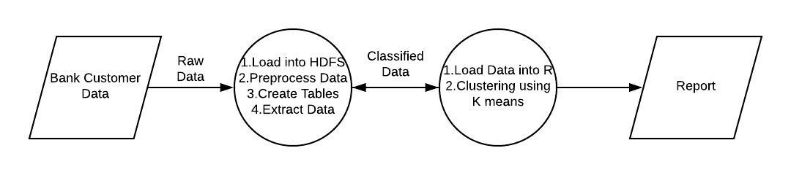
Proposed system context diagram

Slide 11
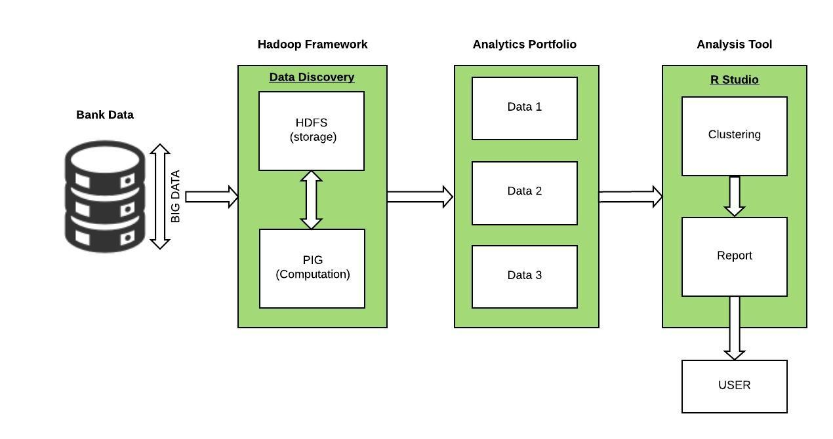
Proposed system system architecture

Slide 12
modules
Preprocessing Data
Creating relationships and tables
Classification of data
Clustering data

Slide 13
DATA FLOW DIAGRAM
MODULE 1
MODULE 2
MODULE 3
MODULE 4
Load into HDFS
Relationships
Extract data
Cluster data
Bank data
Create table
User

Slide 14
Preprocessing Data MODULE 1
Loading and Preprocessing
Raw Data
Processed Data
INPUT – Dataset in Ascii format
OUTPUT – Data in an .csv format
PROCESS -
Load data into HDFS
Use Apache pig commands to clean data

Slide 15
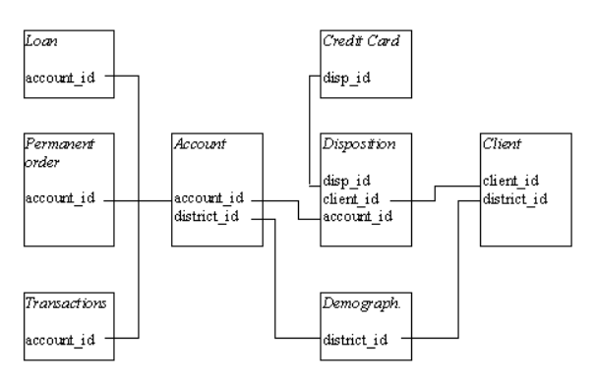
Establishing relationships and creating tables Module 2
Establish relationships
Processed Data
Formatted tables
INPUT - .csv files
OUTPUT - Tables
PROCESS - Pig Latin queries on creating relationships and tables

Slide 16
Extracting data module 3
Apply constraints
Table Data
Classified Data
Parameters considered
Transaction amount
Loan status
Credit card status
Average salary
Age
Unemployment rate
Entrepreneurship rate
Disposition
METHOD
INPUT - Formatted tables
OUTPUT - Three datasets containing high, medium and low risk customers
PROCESS –
Establish query statements using Latin
Classify data into three sets namely high, low and medium risk customers.
Store it into the HDFS

Slide 17

Clustering data Module 4
Clustering in R
Classified Data
Clustered data
K-Means clustering-Formula
METHOD
INPUT - Classified data
OUTPUT - Clustered data
PROCESS –
Load data into R Studio
Cluster using K-means Algorithm
Plot graphs for interface
||x_{i} - v_{j}|| is Eucledian Distance
Ci is number of datapoints in ‘i’ cluster
C cluster centers

Slide 18
ALGORITHM:
Convert ascii files into .csv files
Load into the HDFS of Hadoop Framework
Integrate Pig with HDFS
Join tables corresponding to the constraints
Classify data into three datasets for high, medium and low risk customers using the parameters in Latin language
Load the data into R-Studio
Apply K-means Algorithm
Plot the datasets into a graph

Slide 19
Advantages
Understanding the customer behaviour of a bank.
Analysing the bank data to provide useful behaviour.
Improves the decision making of banks regarding the schemes and loan/credit cards.
Provides graphical and analytical approach towards understanding the customer behaviour.
Identification of target customers.

Slide 20
disadvantages
Having knowledge about Hadoop framework and R programming.
Understanding the bank requirements regarding the provision of schemes and loan/credit cards.
Multi node Hadoop cluster should be set up to implement in real-time scenario.
Does not provide significant difference in case of small datasets.

Slide 21
requirements
Software Requirements
VM ware workstation
Cloudera OS
Hadoop utilities with Apache Pig
R Studio
Eclipse with Maven plugins
Hardware Requirements
Windows 7/8/10 or Unix platform
Minimum 4Gb RAM

Slide 22
references
[1] Feng Li, Beng Chin Ooi, M. Tamer Ozsu, and Sai Wu, ”Distributed data management using MapReduce”, in ACM Comput. Surv. 46, 3, Article 31 (January 2014)
[2] https://www.tutorialspoint.com/apache_pig/apache_pig_user_defined_functions.htm
[3] https://www.tutorialspoint.com/apache_pig
[4] https://www.edureka.co/big-data-and-hadoop
[5] https://www.statmethods.net/r-tutorial/index.html
[6] https://www.dezyre.com/article/difference-between-pig-and-hive-the-two-key-components-of-hadoop-ecosystem/79
[7] https://www.hadoop360.datasciencecentral.com/blog/pig-vs-hive-vs-sql-difference-between-the-big-data-tools

